Slide 1
ACID BASES AND SALTS More about Salts
CHAPTER NUMBER 2

Slide 2
More On Salts
Step 1: Collect some salt samples
Step 2: Check their solubility in water (use distilled water only).
Step 3:Check the action of these solutions on litmus and find the pH using a pH paper.
Step 4:Which of the salts are acidic, basic or neutral?
Step 5: Identify the acid or base used to form the salt.
Notes:
Insert table 2.4
Step 1:Collect the following salt samples – sodium chloride, potassium nitrate, aluminium chloride, zinc sulphate, copper sulphate, sodium acetate, sodium carbonate and sodium hydrogen carbonate (some other salts available can also be taken).
Step 2: Check their solubility in water (use distilled water only).
Step 3:Check the action of these solutions on litmus and find the pH using a pH paper.
Step 4:Which of the salts are acidic, basic or neutral?
Step 5: Identify the acid or base used to form the salt.
Report your observations in the table
Salts of a strong acid and a strong base are neutral with pH value of 7. On the other hand, salts of a strong acid and weak base are acidic with pH value less than 7 and those of a strong base and weak acid are basic in nature, with pH value more than 7

Slide 3
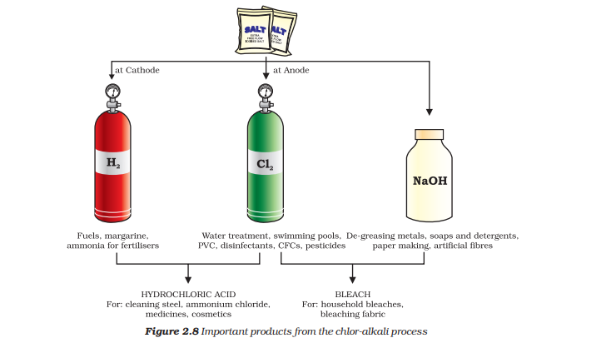
Chemicals from Common Salt
Common salt — A raw material
Sodium hydroxide
Bleaching powder
Baking Soda
Washing Powder
Notes:
Insert figure 2.8
*Common salt — A raw material for chemicals The common salt thus obtained is an important raw material for various materials of daily use, such as sodium hydroxide, baking soda, washing soda, bleaching powder and many more. Let us see how one substance is used for making all these different substances.
* Sodium hydroxide When electricity is passed through an aqueous solution of sodium chloride (called brine), it decomposes to form sodium hydroxide. The process is called the chlor-alkali process because of the products formed– chlore for chlorine and alkali for sodium hydroxide. 2NaCl(aq) + 2H2O(l) → 2NaOH(aq) + Cl2 (g) + H2 (g) Chlorine gas is given off at the anode, and hydrogen gas at the cathode.
Sodium hydroxide solution is formed near the cathode. The three products produced in this process are all useful. Figure 2.8 shows the different uses of these products.
* Bleaching powder You have already come to know that chlorine is produced during the electrolysis of aqueous sodium chloride (brine). This chlorine gas is used for the manufacture of bleaching powder. Bleaching powder is produced by the action of chlorine on dry slaked lime [Ca(OH)2 ]. Bleaching powder is represented as CaOCl2 , though the actual composition is quite complex. Ca(OH)2 + Cl2 → CaOCl2 + H2O Figure 2.8
*Washing soda Another chemical that can be obtained from sodium chloride is Na2CO3 .10H2O (washing soda). You have seen above that sodium carbonate can be obtained by heating baking soda; recrystallisation of sodium carbonate gives washing soda. It is also a basic salt. Na2CO3+10H2O= Na2CO3.10 H2O
What does 10H2O signify? Does it make Na2CO3 wet? We will address this question in the next section. Sodium carbonate and sodium hydrogencarbonate are useful chemicals for many industrial processes as well.
Uses of washing soda
(i) Sodium carbonate (washing soda) is used in glass, soap and paper industries.
(ii) It is used in the manufacture of sodium compounds such as borax. (iii) Sodium carbonate can be used as a cleaning agent for domestic purposes.
(iv) It is used for removing permanent hardness of water

Slide 4
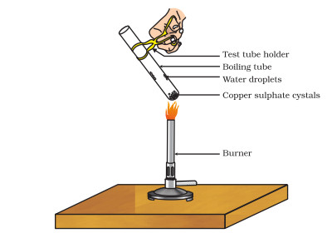
Are the Crystals of Salts really Dry?
Step 1:Heat a few crystals of copper sulphate in a dry boiling tube.
What is the colour of the copper sulphate after heating?
Do you notice water droplets in the boiling tube? Where have these come from?
Step 2: Add 2-3 drops of water on the sample of copper sulphate obtained after heating.
Notes:
Step 1:Heat a few crystals of copper sulphate in a dry boiling tube.
What is the colour of the copper sulphate after heating?
Do you notice water droplets in the boiling tube? Where have these come from?
Step 2: Add 2-3 drops of water on the sample of copper sulphate obtained after heating.
What do you observe?
INFERENCE:
Is the blue colour of copper sulphate restored? Removing water of crystallisation Copper sulphate crystals which seem to be dry contain water of crystallisation. When we heat the crystals, this water is removed and the salt turns white. If you moisten the crystals again with water, you will find that blue colour of the crystals reappears. Water of crystallisation is the fixed number of water molecules present in one formula unit of a salt. Five water molecules are present in one formula unit of copper sulphate. Chemical formula for hydrated copper sulphate is Cu SO4 . 5H2O. Now you would be able to answer the question whether the molecule of Na2CO3 .10H2O is wet. One other salt, which possesses water of crystallisation is gypsum. It has two water molecules as water of cyrstallisation. It has the chemical formula CaSO4 .2H2O. Let us look into the use of this salt.
Plaster of Paris On heating gypsum at 373 K, it loses water molecules and becomes calcium sulphate hemihydrate( CaSO4 .1/2 H O 2 ). This is called Plaster of Paris.
Paris, the substance which doctors use as plaster for supporting fractured bones in the right position. Plaster of Paris is a white powder and on mixing with water, it changes to gypsum once again giving a hard solid mass.
CaSO4.1/2 H O +3/2 H2O =CaSO4 .2H2O
(Plaster of Paris) (Gypsum)
Note that only half a water molecule is shown to be attached as water of crystallisation. How can you get half a water molecule? It is written in this form because two formula units of CaSO4 share one molecule of water. Plaster of Paris is used for making toys, materials for decoration and for making surfaces smooth. Try to find out why is calcium sulphate hemihydrate called ‘Plaster of Paris’ ?

Slide 5
CONCLUSION
In this part we learnt about:
More On Salts
Chemicals from Common Salt
Are the Crystals of Salts really Dry?

